Slide 1
SYMMETRICAL COMPONENTS AND UNBALANCED FAULTS
Chapter -10
Power System Analysis by
Hadi Saadat

Slide 2
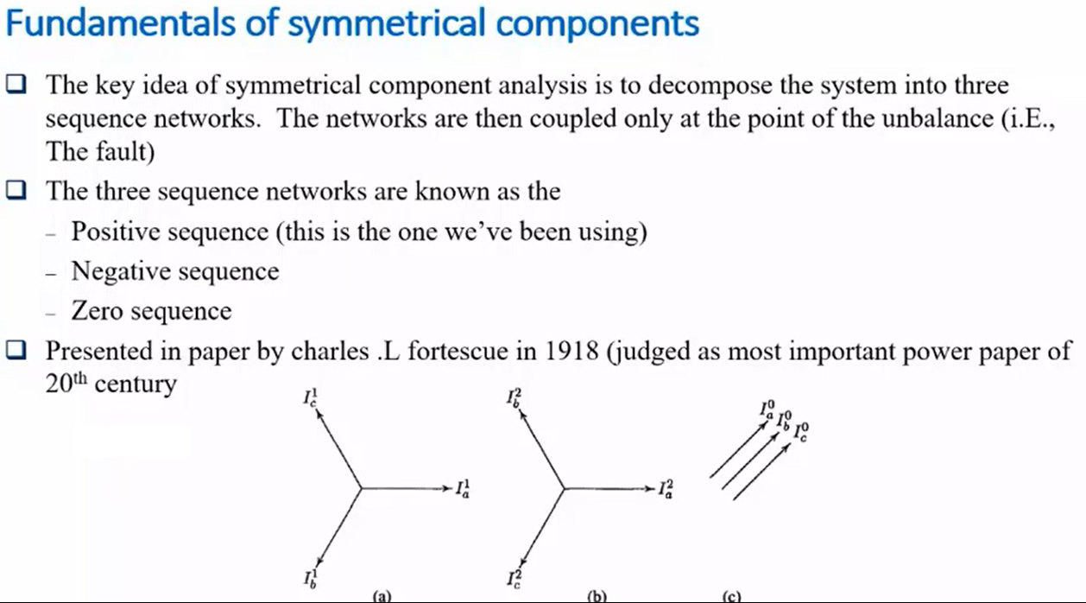
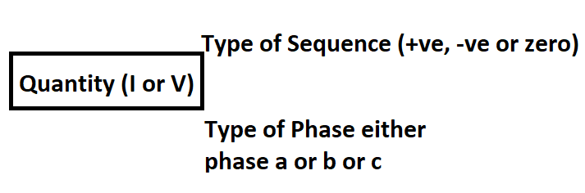
1 used for
positive sequence
Same phase sequences also draw for voltages
Here c represent as a phase or phase c

Slide 3
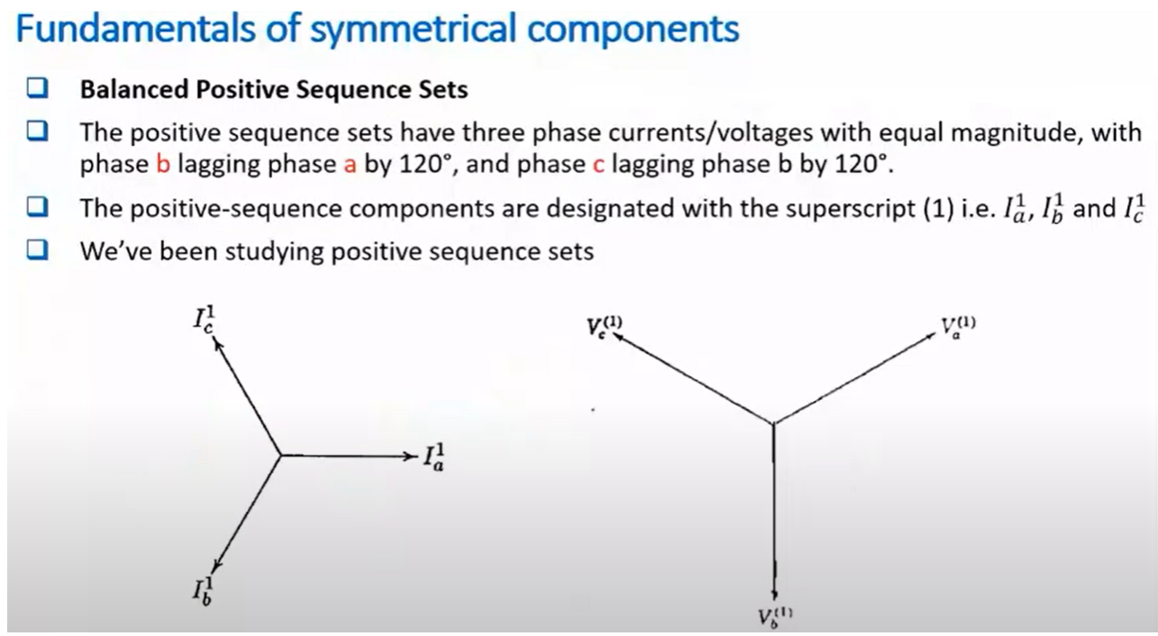
Counter clock

Slide 4
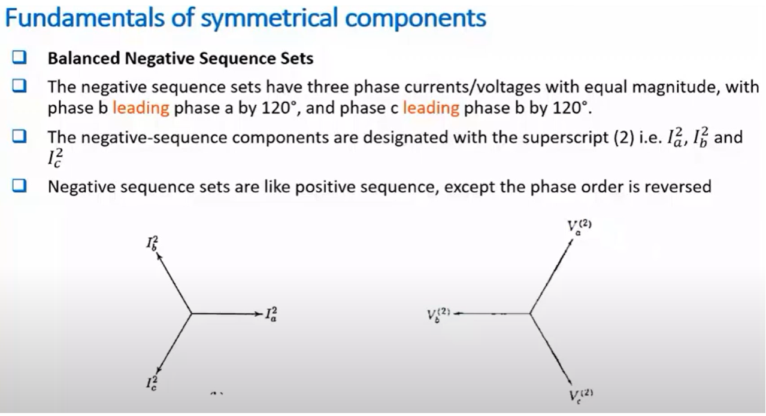
Minor difference between positive and negative is sequence is that it changes two phases

Slide 5
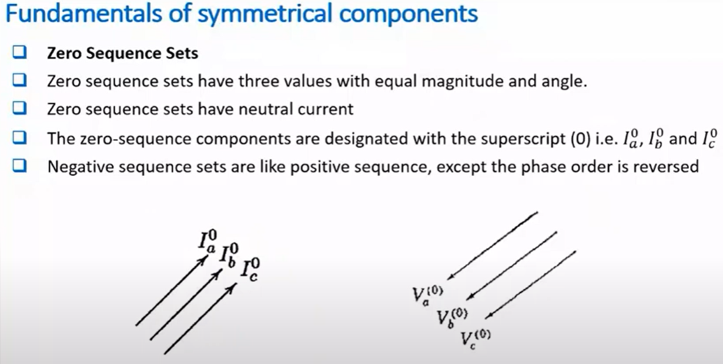

Slide 6
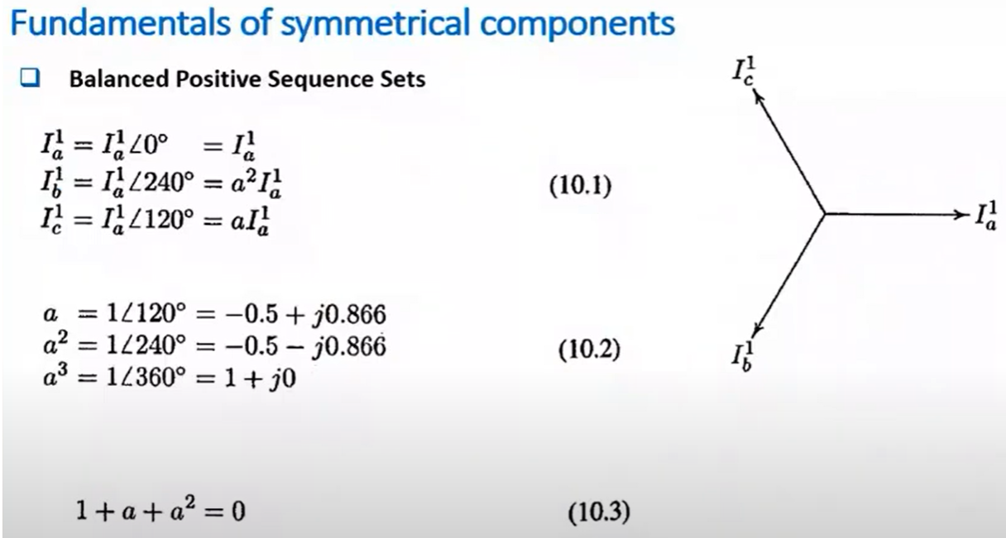
I_{b} power 1 is a 2 rotation of a to reach at b

Slide 7
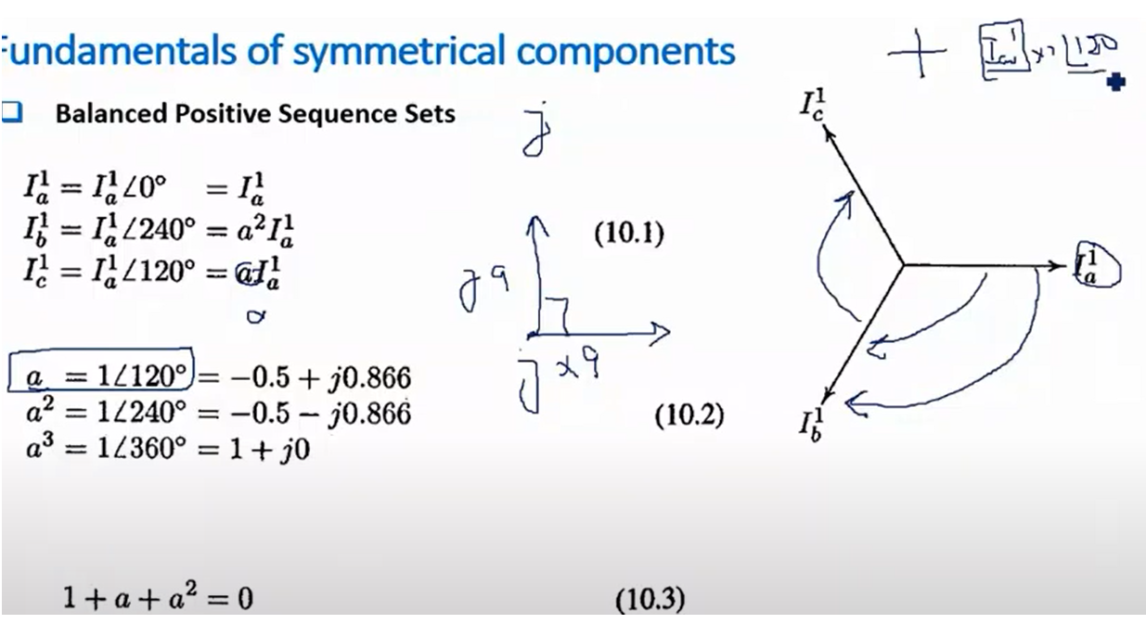
J operator is just rotation of 90 degrees.
A operator is a rotation of 120 degrees

Slide 8
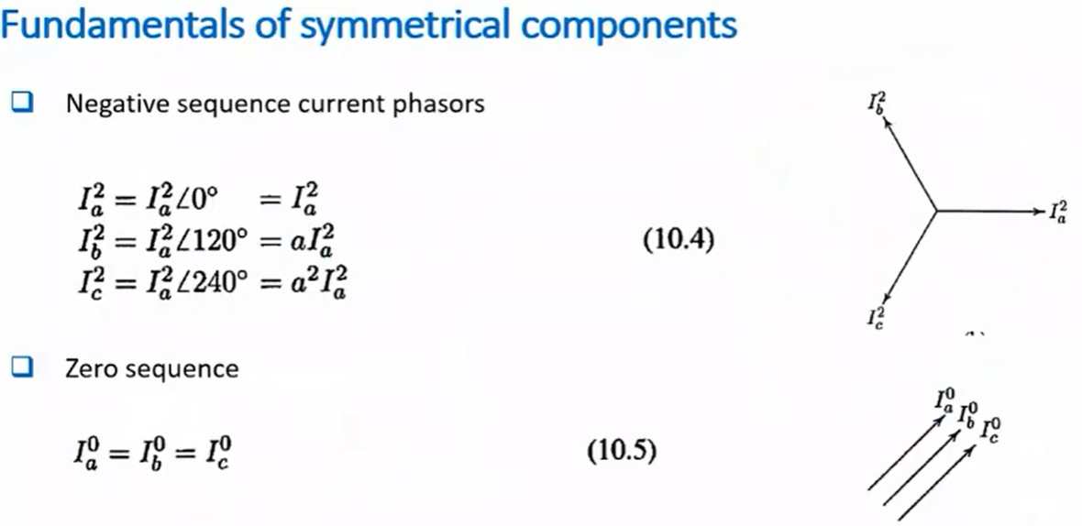

Slide 9
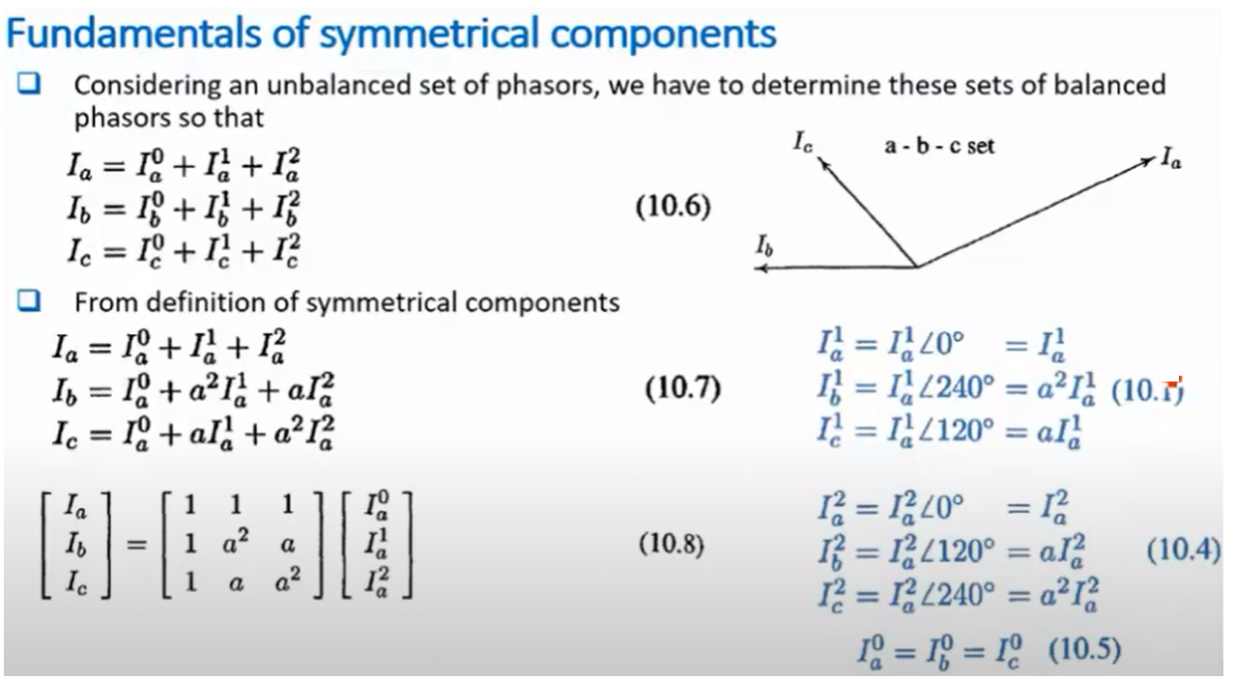
unbalance

Slide 10
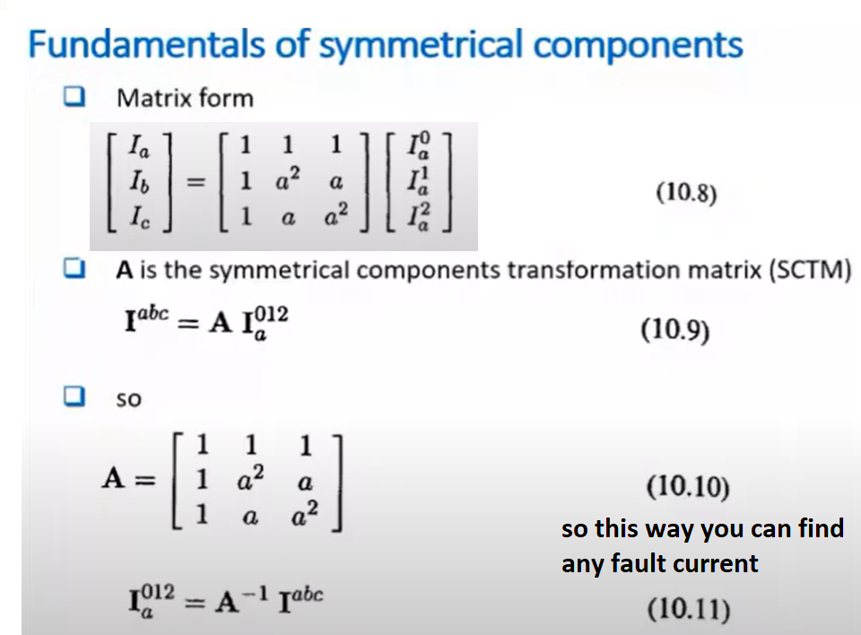
Through this formula you can find phase components
Through this formula
you can find sequence
components

Slide 11
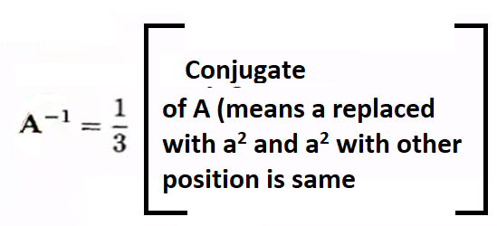
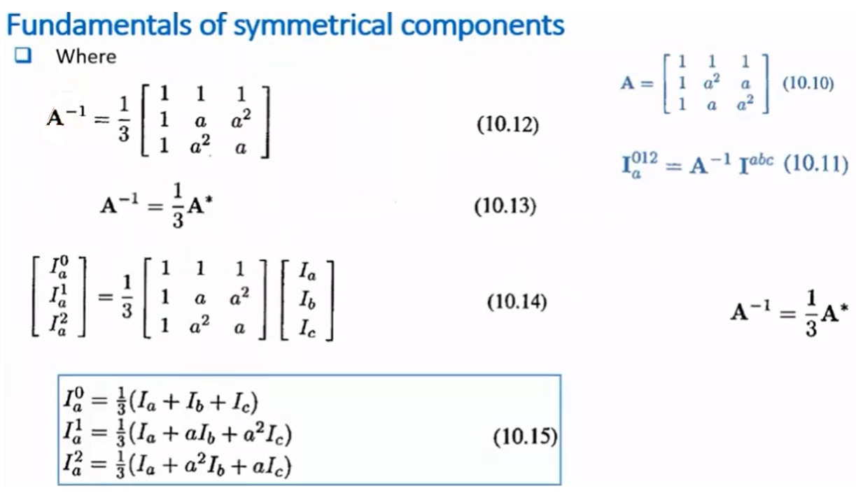

Slide 12
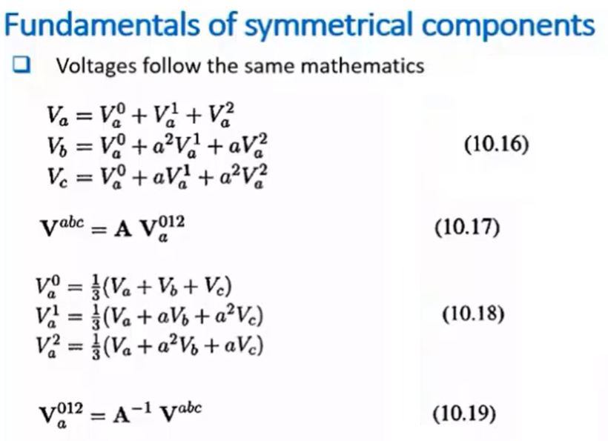
Similarly, we calculate voltages

Slide 13
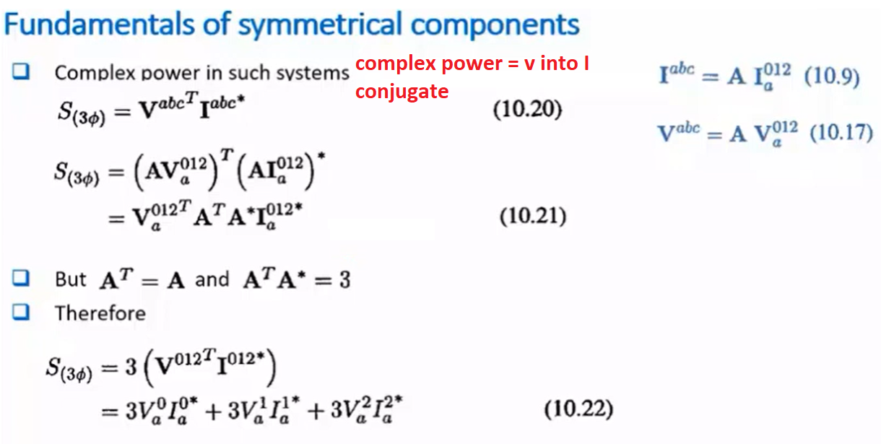

Slide 14
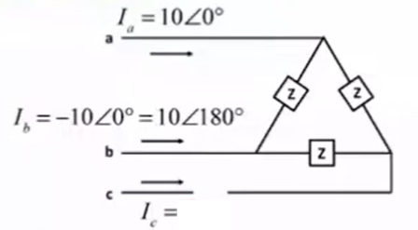
Example 11.1 (From Stevension Book)
One conductor of a three-phase line is open. The current flowing to the Δ-connected load through line a is 10A. With the current in line a as a reference and assuming that line c is open, find the symmetrical components of the line currents.

Slide 15
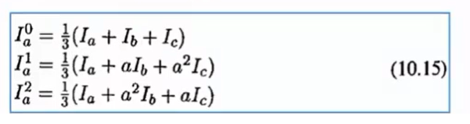
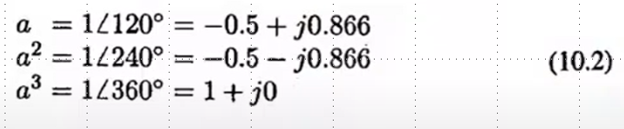
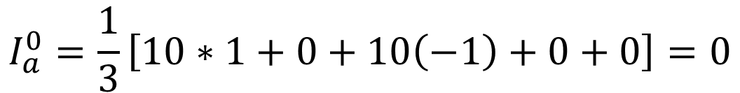
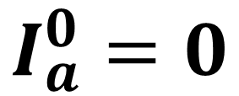
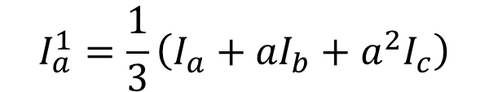
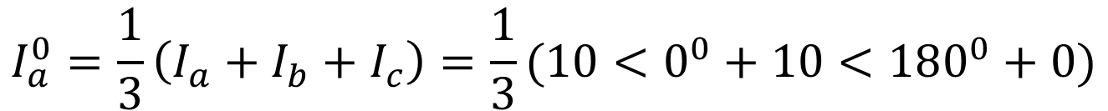
SOLUTION
$$I_{a}^{0}=\frac{1}{3}\left(I_{a}+I_{b}+I_{c}\right)=\frac{1}{3}(10<0^{0}+10<180^{0}+0)$$
$$I_{a}^{0}=\frac{1}{3}\left[10\cos\left(0^{0}\right)+j\sin\left(0^{0}\right)+10\cos\left({180}^{0}\right)+j\sin\left({180}^{0}\right)+0\right]$$
$$I_{a}^{0}=\frac{1}{3}\left[10∗1+0+10\left(−1\right)+0+0\right]=0$$
$$I_{a}^{0}=0$$
$$I_{a}^{1}=\frac{1}{3}\left(I_{a}+{aI}_{b}+a^{2}I_{c}\right)$$
$$I_{a}^{1}=\frac{1}{3}\left(10<0^{0}+1<120^{0}∗10<{180}^{0}+1<240^{0}∗0\right)=\frac{1}{3}(10+10<300^{0})$$
$$I_{a}^{1}=\frac{1}{3}(10+10\cos\left(300^{0}\right)+j10sin\left(300^{0}\right)=\frac{1}{3}\left(10+10 ∗\frac{1}{2}−j10∗\frac{\sqrt{3}}{2}\right)$$

Slide 16
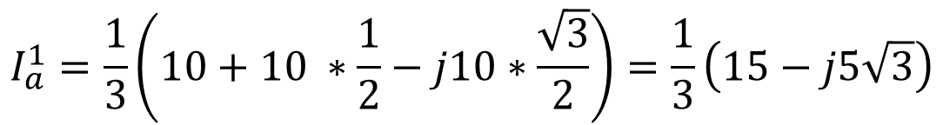

$$I_{a}^{1}=\frac{1}{3}\left(10+10 ∗\frac{1}{2}−j10∗\frac{\sqrt{3}}{2}\right)=\frac{1}{3}\left(15−j5\sqrt{3}\right)$$
$${Magnitude of I}_{a}^{1}=\frac{1}{3}\left(\sqrt{{\left(15\right)}^{2}+ {\left(5\sqrt{3}\right)}^{2 }}\right)=\frac{1}{3}\left(\sqrt{225+25∗3}\right)=\frac{1}{3}(\sqrt{225+75})$$
$${Magnitude of I}_{a}^{1}=\frac{1}{3}\left(\sqrt{300}\right)=\frac{1}{3}\left(17.320\right)=5.78$$
$${Phase Angle of I}_{a}^{1}=\frac{1}{3}\left(15−j5\sqrt{3}\right)= \left(5−j\frac{5}{\sqrt{3}}\right)=\left(5−j2.89\right)$$
$${Phase Angle of I}_{a}^{1}= \tan^{−1}\left(\frac{−2.89}{5}\right)=\tan^{−1}\left(−0.577\right)=−{30}^{0}$$
$$I_{a}^{1}= 5.78<−{30}^{0}$$

Slide 17
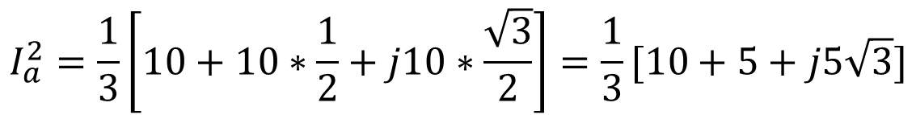
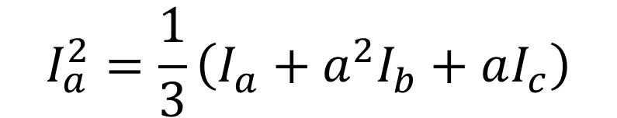
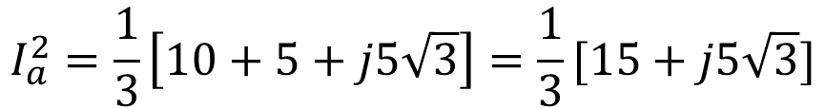
$$I_{a}^{2}=\frac{1}{3}\left(I_{a}+{a^{2}I}_{b}+aI_{c}\right)$$
$$I_{a}^{2}=\frac{1}{3}\left(10<0^{0}+1<240^{0}∗10<{180}^{0}+0\right)=\frac{1}{3}(10+10<420^{0})$$
$$I_{a}^{2}=\frac{1}{3}\left(10+10<420^{0}\right)=\frac{1}{3}[10+10\cos\left(420^{0}\right)+j10\sin\left(420^{0}\text{)}\right]$$
$$I_{a}^{2}=\frac{1}{3}\left[10+10∗\frac{1}{2}+j10∗\frac{\sqrt{3}}{2}\right]=\frac{1}{3}[10+5+j5\sqrt{3}]$$
$$I_{a}^{2}=\frac{1}{3}\left[10+5+j5\sqrt{3}\right]=\frac{1}{3}[15+j5\sqrt{3}]$$
$${Magnitude of I}_{a}^{2}=\frac{1}{3}\left(\sqrt{{\left(15\right)}^{2}+ {\left(5\sqrt{3}\right)}^{2 }}\right)=\frac{1}{3}\left(\sqrt{225+25∗3}\right)=\frac{1}{3}(\sqrt{225+75})$$
$${Magnitude of I}_{a}^{2}=\frac{1}{3}\left(\sqrt{300}\right)=\frac{1}{3}\left(17.320\right)=5.78$$

Slide 18

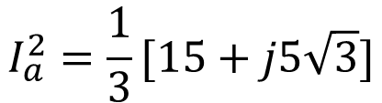
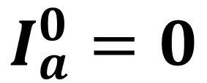


$${Phase Angle of I}_{a}^{2}=\frac{1}{3}\left(15+j5\sqrt{3}\right)= \left(5+j\frac{5}{\sqrt{3}}\right)=\left(5+j2.89\right)$$
$$I_{a}^{2}=\frac{1}{3}[15+j5\sqrt{3}]$$
$${Phase Angle of I}_{a}^{2}= \tan^{−1}\left(\frac{2.89}{5}\right)=\tan^{−1}\left(0.577\right)={30}^{0}$$
$$I_{a}^{2}= 5.78<{30}^{0}$$
$$I_{a}^{0}=0$$
$$I_{a}^{1}= 5.78<−{30}^{0}$$
$$I_{a}^{2}= 5.78<{30}^{0}$$

Slide 19
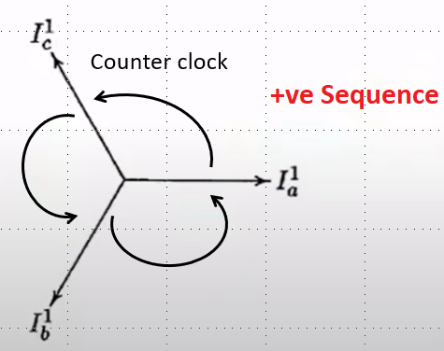
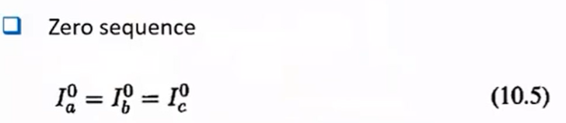
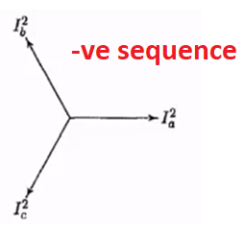
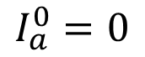


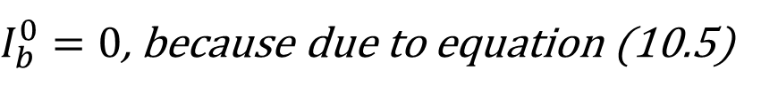


$I_{b}^{0}=0$, because due to equation (10.5)
$$I_{a}^{0}=0$$
$$I_{a}^{1}= 5.78<−{30}^{0}$$
$$I_{b}^{0}=0$$
$$I_{a}^{2}= 5.78<{30}^{0}$$
$I_{b}^{1}=I_{a}^{1}<−120^{0}=5.78<−{30}^{0}<−120^{0}=5.78$ $<−150^{0}$
$I_{b}^{2}=I_{a}^{2}<120^{0}=5.78<{30}^{0}<120^{0}=5.78$ $<150^{0}$
$$I_{b}^{0}=0$$
$I_{b}^{1}=5.78$ $<−150^{0}$
$I_{b}^{2}=5.78$ $<150^{0}$

Slide 20

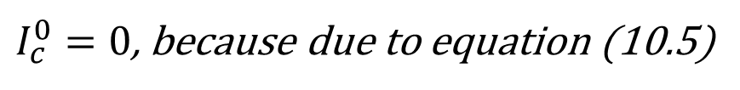
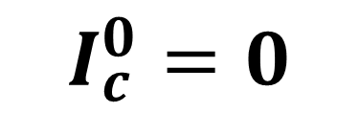
$I_{c}^{0}=0$, because due to equation (10.5)
$$I_{a}^{0}=0$$
$$I_{a}^{1}= 5.78<−{30}^{0}$$
$$I_{c}^{0}=0$$
$$I_{a}^{2}= 5.78<{30}^{0}$$
$I_{c}^{1}=I_{a}^{1}<120^{0}=5.78<−{30}^{0}<120^{0}=5.78$ $<90^{0}$
$I_{c}^{2}=I_{a}^{2}<−120^{0}=5.78<{30}^{0}<−120^{0}=5.78$ $<−90^{0}$
$$I_{c}^{0}=0$$
$I_{c}^{1}=5.78$ $<90^{0}$
$I_{c}^{2}=5.78$ $<−90^{0}$

Slide 21
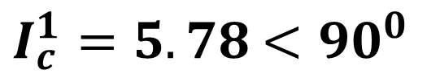
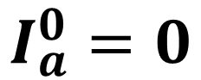
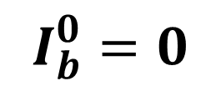
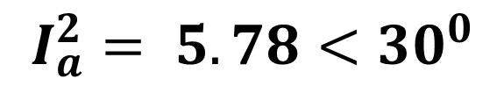
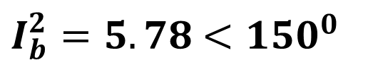
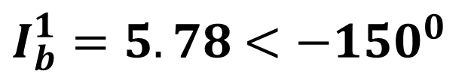
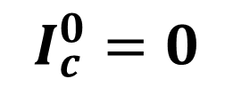
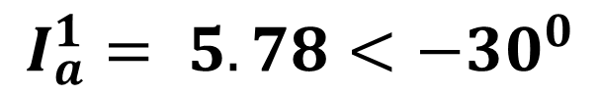
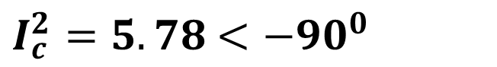
$$I_{a}^{0}=0$$
$$I_{a}^{1}= 5.78<−{30}^{0}$$
$$I_{a}^{2}= 5.78<{30}^{0}$$
$$I_{b}^{0}=0$$
$I_{b}^{1}=5.78$ $<−150^{0}$
$I_{b}^{2}=5.78$ $<150^{0}$
$$I_{c}^{0}=0$$
$I_{c}^{1}=5.78$ $<90^{0}$
$I_{c}^{2}=5.78$ $<−90^{0}$
We can observe that magnitude and angles are same, so now system is converted into Balance System----- Answer

Slide 22
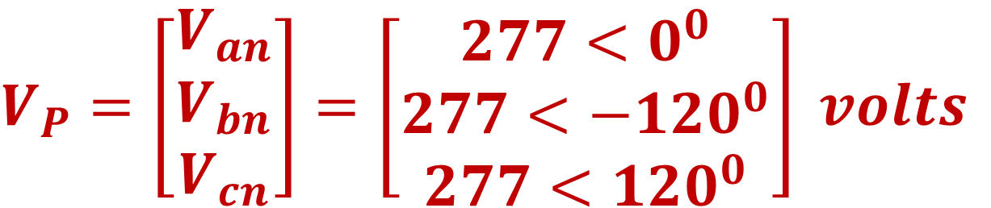
EXAMPLE 8.1 Calculate the sequence components of the following balanced line-to-neutral voltages with abc sequence
$$V_{P}=\left[\begin{matrix}V_{an} \\ V_{bn} \\ V_{cn}\end{matrix}\right]=\left[\begin{matrix}277<0^{0} \\ 277<−120^{0} \\ 277<120^{0}\end{matrix}\right] volts$$

Slide 23

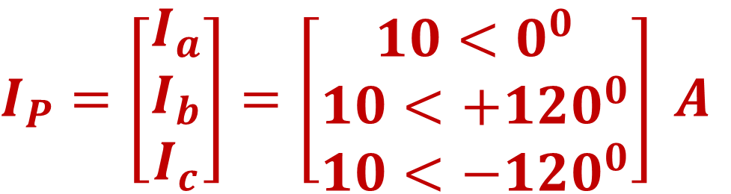
EXAMPLE 8.2 A Y-connected load has balanced currents with abc sequence given by
$$I_{P}=\left[\begin{matrix}I_{a} \\ I_{b} \\ I_{c}\end{matrix}\right]=\left[\begin{matrix}10<0^{0} \\ 10<+120^{0} \\ 10<−120^{0}\end{matrix}\right] A$$
Calculate the sequence currents ($I_{0}$, $I_{1}$, $I_{2}$)

Slide 24
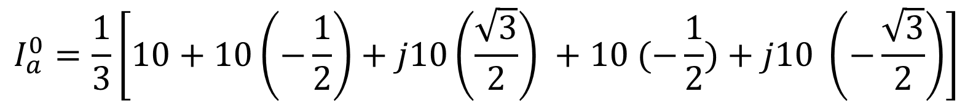
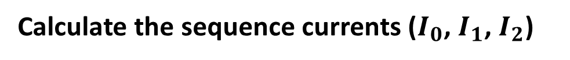
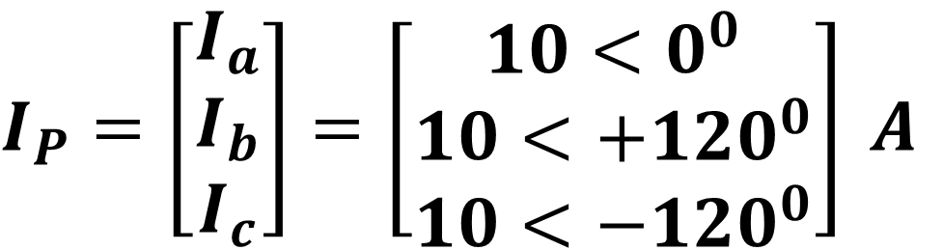
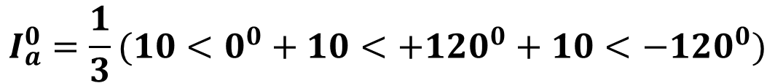
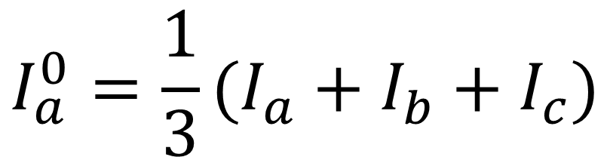
SOLUTION
$$I_{P}=\left[\begin{matrix}I_{a} \\ I_{b} \\ I_{c}\end{matrix}\right]=\left[\begin{matrix}10<0^{0} \\ 10<+120^{0} \\ 10<−120^{0}\end{matrix}\right] A$$
$$I_{a}^{0}=\frac{1}{3}(I_{a}+I_{b}+I_{c})$$
Calculate the sequence currents ($I_{0}$, $I_{1}$, $I_{2}$)
$$I_{a}^{0}=\frac{1}{3}(10<0^{0}+10<+120^{0}+10<−120^{0})$$
$$I_{a}^{0}=\frac{1}{3}\left[10+10cos120^{0}+j10sin120^{0}+10cos(−120^{0})+j10sin(−120^{0})\right]$$
$$I_{a}^{0}=\frac{1}{3}\left[10+10\left(−\frac{1}{2}\right)+j10\left(\frac{\sqrt{3}}{2}\right) +10 (−\frac{1}{2})+j10 \left(−\frac{\sqrt{3}}{2}\right)\right]$$

Slide 25





$$I_{a}^{0}=\frac{1}{3}\left[10+10\left(−\frac{1}{2}\right)+j10\left(\frac{\sqrt{3}}{2}\right) +10 (−\frac{1}{2})+j10 \left(−\frac{\sqrt{3}}{2}\right)\right]$$
$$I_{P}=\left[\begin{matrix}I_{a} \\ I_{b} \\ I_{c}\end{matrix}\right]=\left[\begin{matrix}10<0^{0} \\ 10<+120^{0} \\ 10<−120^{0}\end{matrix}\right] A$$
$$I_{a}^{0}=\frac{1}{3}\left[10−5+j5\sqrt{3} −5−j5\sqrt{3}\right]=0$$
$$I_{a}^{1}=\frac{1}{3}\left(I_{a}+{aI}_{b}+a^{2}I_{c}\right)=\frac{1}{3}(10<0^{0}+1<120^{0}∗10<120^{0}+1<240^{0}∗10<−120^{0})$$
$$I_{a}^{1}=\frac{1}{3}(10<0^{0}+10<240^{0}+10<120^{0})$$
$$I_{a}^{1}=\frac{1}{3}\left(10+10\cos\left(240^{0}\right)+j10\sin\left(240^{0}\right)+10\cos\left(120^{0}\right)+j10\sin\left(120^{0}\right)\right)$$
$$I_{a}^{1}=\frac{1}{3}\left(10+10\left(−\frac{1}{2}\right)+10\left(−j\frac{\sqrt{3}}{2}\right)+10\left(−\frac{1}{2}\right)+j10\left(\frac{\sqrt{3}}{2}\right)\right)$$

Slide 26




$$I_{a}^{1}=\frac{1}{3}\left(10+10\left(−\frac{1}{2}\right)+10\left(−j\frac{\sqrt{3}}{2}\right)+10\left(−\frac{1}{2}\right)+j10\left(\frac{\sqrt{3}}{2}\right)\right)$$
$$I_{P}=\left[\begin{matrix}I_{a} \\ I_{b} \\ I_{c}\end{matrix}\right]=\left[\begin{matrix}10<0^{0} \\ 10<+120^{0} \\ 10<−120^{0}\end{matrix}\right] A$$
$$I_{a}^{1}=\frac{1}{3}\left(10−5−j5\sqrt{3}−5+j5\sqrt{3}\right)$$
$$I_{a}^{1}=\frac{1}{3}\left(5−10−j5\sqrt{3}+j5\sqrt{3}\right)$$
$$I_{a}^{1}=0$$

Slide 27




$$I_{a}^{2}=\frac{1}{3}\left(I_{a}+{a^{2}I}_{b}+{aI}_{c}\right)=\frac{1}{3}(10<0^{0}+1<240^{0}∗10<120^{0}+1<120^{0}∗10<−120^{0})$$
$$I_{a}^{2}=\frac{1}{3}\left(10+10<360^{0}+10<0^{0}\right)$$
$$I_{P}=\left[\begin{matrix}I_{a} \\ I_{b} \\ I_{c}\end{matrix}\right]=\left[\begin{matrix}10<0^{0} \\ 10<+120^{0} \\ 10<−120^{0}\end{matrix}\right] A$$
$$I_{a}^{2}=\frac{1}{3}\left(10+10cos360^{0}+j10sin360^{0}+10\right)$$
$$I_{a}^{2}=\frac{1}{3}\left(10+10∗1+j10∗0+10\right)$$
$$I_{a}^{2}=\frac{1}{3}\left(30\right)=10{<0}^{0}$$
$$I_{a}^{0}=0 OR { I}_{0}=0$$
$$I_{a}^{1}=0 OR I_{1}=0$$
$$I_{a}^{2}= 10{<0}^{0 } OR I_{2}= 10{<0}^{0 }$$

Slide 28
$$I_{a}^{0}=0 OR { I}_{0}=0$$
$$I_{a}^{1}=0 OR I_{1}=0$$
$$I_{a}^{2}= 10{<0}^{0 } OR I_{2}= 10{<0}^{0 }$$
This example illustrates the fact that balanced three-phase systems with acb sequence (or negative sequence) have no zero-sequence or positive-sequence components. For this example the negative-sequence current I₂ equals I_{a,} and the zero-sequence and positive-sequence currents are both zero.

Slide 29


Slide 30

Mutual Induction or mutual coupling such as Transformer or Transmission Line cases
So we take voltage with a reference in this case we used ground as a reference
Self impedance coupling

Slide 31




$$Using KCL$$
$$I_{n}={I_{a}+I_{b}+I}_{c} (10.24)$$
$$Put the value in equation (10.23)$$
$V_{a}=Z_{s}I_{a}+$ $Z_{m}I_{b}+Z_{m}I_{c}+Z_{n}({I_{a}+I_{b}+I}_{c})$
$V_{b}=Z_{m}I_{a}+$ $Z_{s}I_{b}+Z_{m}I_{c}+Z_{n}({I_{a}+I_{b}+I}_{c})$
$V_{c}=Z_{m}I_{a}+$ $Z_{m}I_{b}+Z_{s}I_{c}+Z_{n}({I_{a}+I_{b}+I}_{c})$

Slide 32
$V_{a}=Z_{s}I_{a}+$ $Z_{m}I_{b}+Z_{m}I_{c}+Z_{n}({I_{a}+I_{b}+I}_{c})$
$V_{b}=Z_{m}I_{a}+$ $Z_{s}I_{b}+Z_{m}I_{c}+Z_{n}({I_{a}+I_{b}+I}_{c})$
$V_{c}=Z_{m}I_{a}+$ $Z_{m}I_{b}+Z_{s}I_{c}+Z_{n}({I_{a}+I_{b}+I}_{c})$
$V_{a}=Z_{s}I_{a}+$ $Z_{m}I_{b}+Z_{m}I_{c}+Z_{n}I_{a}+Z_{n}I_{b}+Z_{n}I_{c}$
$V_{a}={(Z}_{s}{+Z_{n})I}_{a}+$ ($Z_{m}{+Z_{n})I}_{b}+{(Z}_{m}{+Z_{n})I}_{c}$
$V_{b}=Z_{m}I_{a}+$ $Z_{s}I_{b}+Z_{m}I_{c}+Z_{n}I_{a}+Z_{n}I_{b}+Z_{n}I_{c}$
$V_{b}={(Z}_{m}{+Z_{n})I}_{a}+$ $(Z_{s}+Z_{n})I_{b}+{(Z_{m}+Z_{n})I}_{c}$
$V_{c}=Z_{m}I_{a}+$ $Z_{m}I_{b}+Z_{s}I_{c}+Z_{n}I_{a}+Z_{n}I_{b}+Z_{n}I_{c}$
$V_{c}={(Z}_{m}{+Z_{n})I}_{a}+$ $(Z_{m}+Z_{n})I_{b}+{(Z_{s}+Z_{n})I}_{c}$

Slide 33

$V_{a}={(Z}_{s}{+Z_{n})I}_{a}+$ ($Z_{m}{+Z_{n})I}_{b}+{(Z}_{m}{+Z_{n})I}_{c}$
$V_{b}={(Z}_{m}{+Z_{n})I}_{a}+$ $(Z_{s}+Z_{n})I_{b}+{(Z_{m}+Z_{n})I}_{c}$
$V_{c}={(Z}_{m}{+Z_{n})I}_{a}+$ $(Z_{m}+Z_{n})I_{b}+{(Z_{s}+Z_{n})I}_{c}$
Convert these equations into matrix forms
$$\left[\begin{matrix}V_{a} \\ V_{b} \\ V_{b}\end{matrix}\right]=\left[\begin{matrix}Z_{s}+Z_{n} & Z_{m}+Z_{n} & Z_{m}+Z_{n} \\ Z_{m}+Z_{n} & Z_{s}+Z_{n} & Z_{m}+Z_{n} \\ Z_{m}+Z_{n} & Z_{m}+Z_{n} & Z_{s}+Z_{n}\end{matrix}\right]\left[\begin{matrix}I_{a} \\ I_{b} \\ I_{c}\end{matrix}\right] (10.25)$$
Write in Compact form
$$V^{abc}={Z^{abc}I}^{abc} (10.26)$$

Slide 34






Convert these equations into matrix forms
$$Z^{abc}=\left[\begin{matrix}Z_{s}+Z_{n} & Z_{m}+Z_{n} & Z_{m}+Z_{n} \\ Z_{m}+Z_{n} & Z_{s}+Z_{n} & Z_{m}+Z_{n} \\ Z_{m}+Z_{n} & Z_{m}+Z_{n} & Z_{s}+Z_{n}\end{matrix}\right] (10.27)$$
$$V^{abc}={Z^{abc}I}^{abc} (10.26)$$
Now convert equation (10.26) of each phasor domain vector into corresponding symmetrical components.
$${AV}_{a}^{012}= V^{abc}$$
$$V^{abc}={Z^{abc}I}^{abc}$$
$${AV}_{a}^{012}={Z^{abc}AI}_{a}^{012} (10.28)$$
$${AI}_{a}^{012}= I^{abc}$$

Slide 35






Multiply A⁻¹ on both sides with equation (10.28)
$${A^{−1}AV}_{a}^{012}=A^{−1}{Z^{abc}AI}_{a}^{012}$$
$${AV}_{a}^{012}={Z^{abc}AI}_{a}^{012} (10.28)$$
$V_{a}^{012}=A^{−1}{Z^{abc}AI}_{a}^{012} (10.29)$
$$Z_{a}^{012}=A^{−1}Z^{abc}$$
$$V_{a}^{012}=I_{a}^{012}{(A}^{−1}Z^{abc}A)$$
$$V=IZ$$
${where (A}^{−1}Z^{abc}A)$ ${=Z}^{012}$ (10.30)

Slide 36



Put values in equation (10.30)
$$Z^{012}=A^{−1}Z^{abc}A$$
Observed principal diagonal available and off diagonal all are zeros
If not mutual coupling between them, then Z_{m} = 0

Slide 37


